Slide 1
Symmedian Point
By Siyu Sun

Slide 2
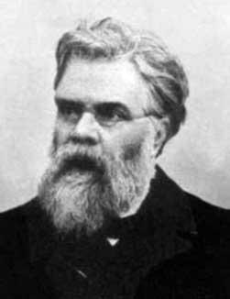
Symmedian Point is the intersection of three Symmedians of a triangle.
Symmedians are lines that are isogonal to the triangle’s medians. Émile Lemoine, a French mathematician, discovered symmedian point in 1873. So sometimes it is also called Lemoine Point.
Notes:
One of the most important triangle center

Slide 3
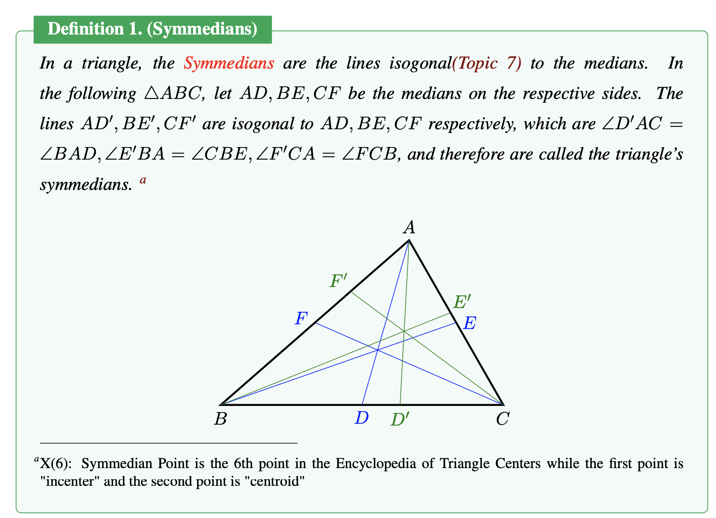
Notes:
Angle bisector symmetry

Slide 4
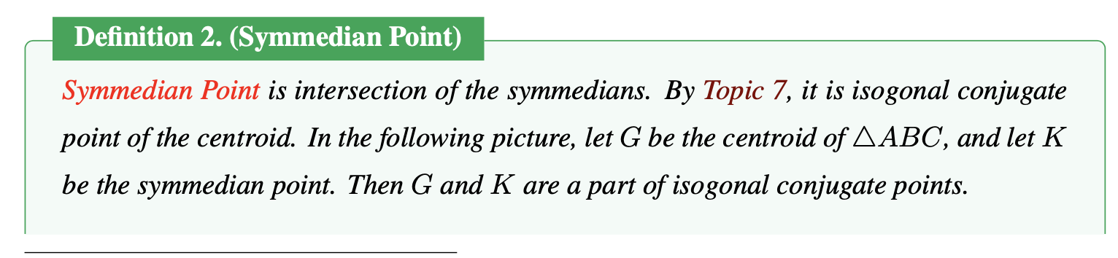
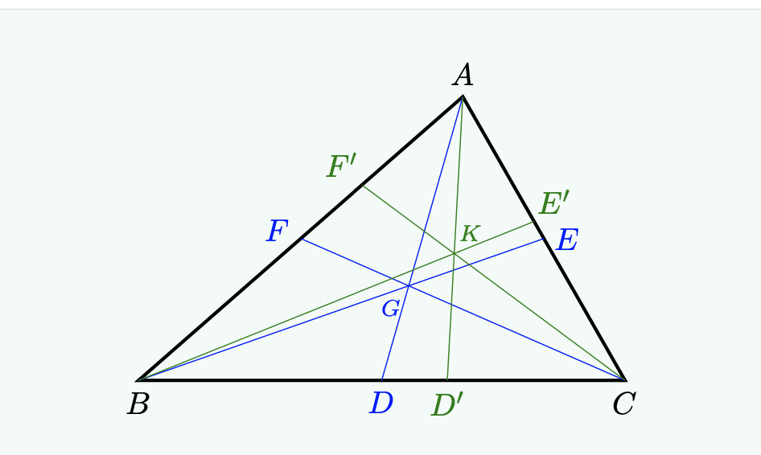

Slide 5
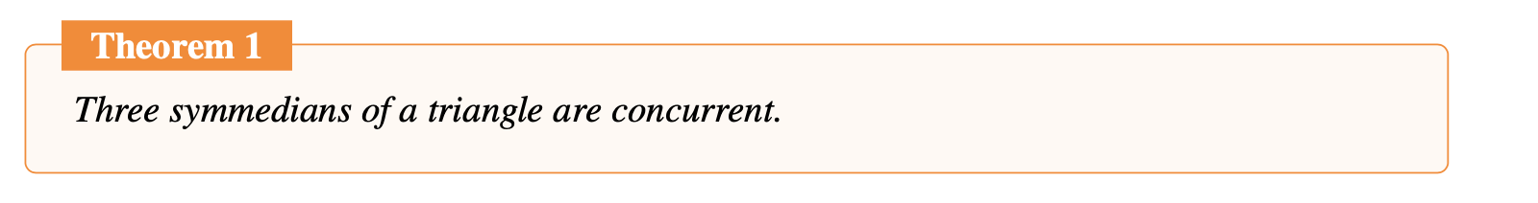
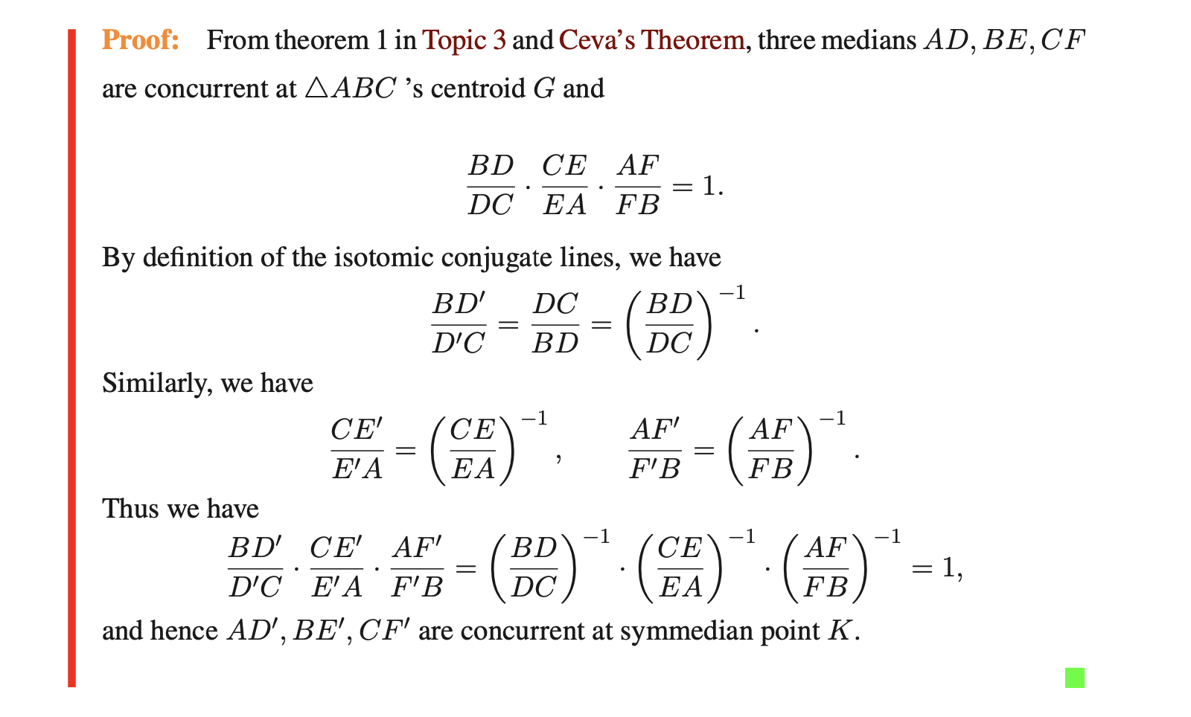

Slide 6

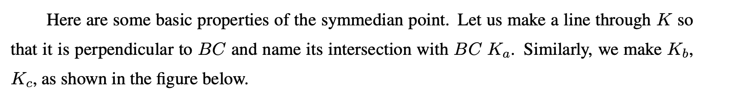
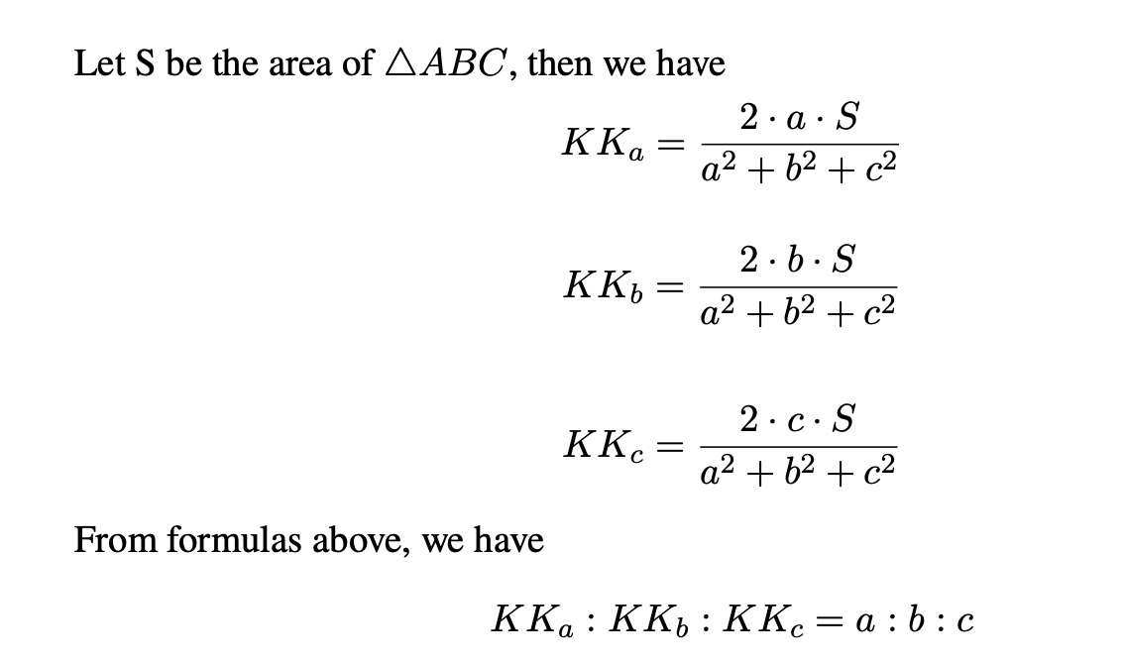
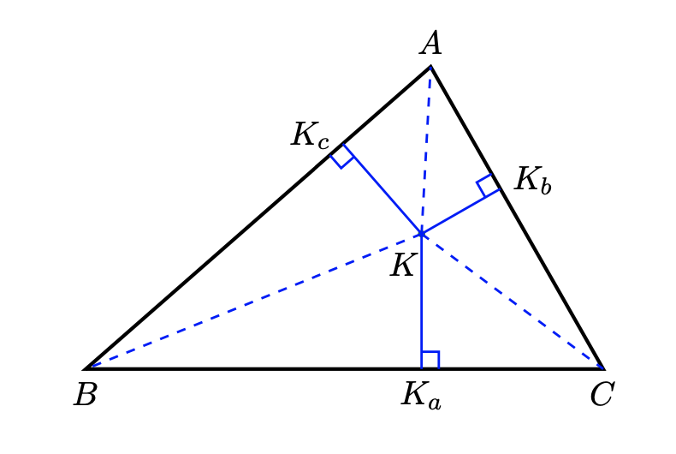

Slide 7
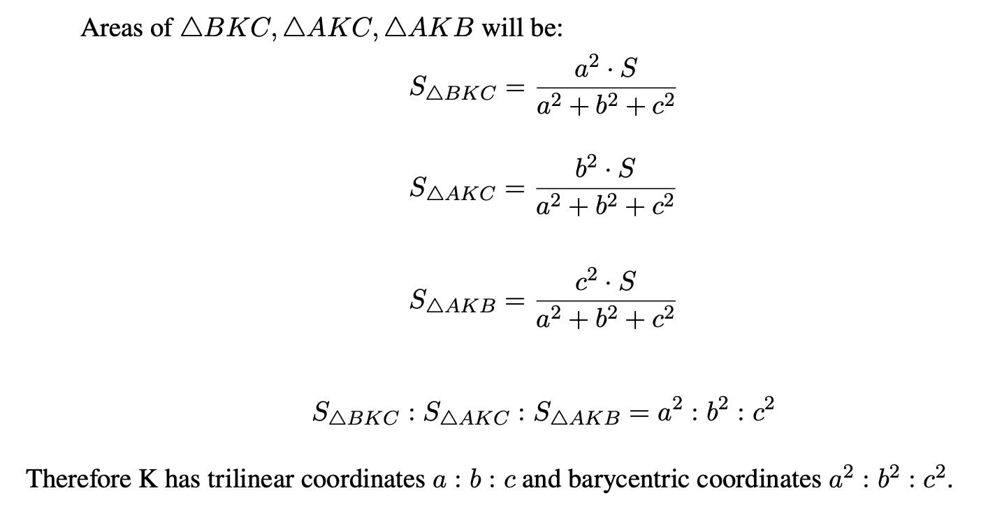

Slide 8
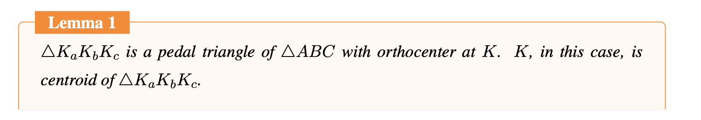
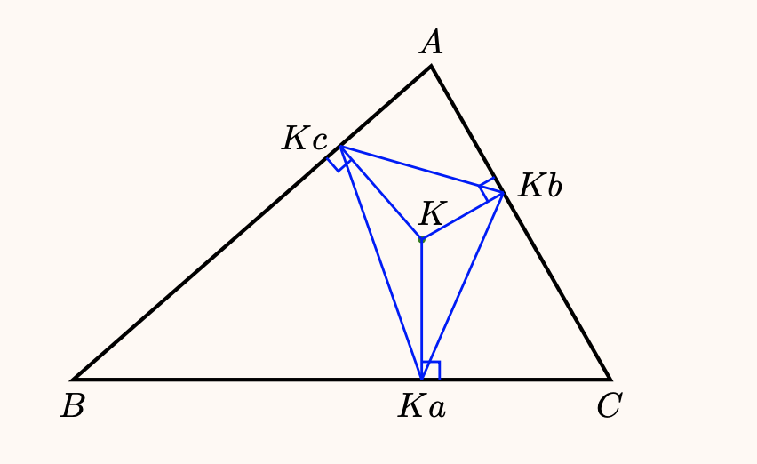

Slide 9
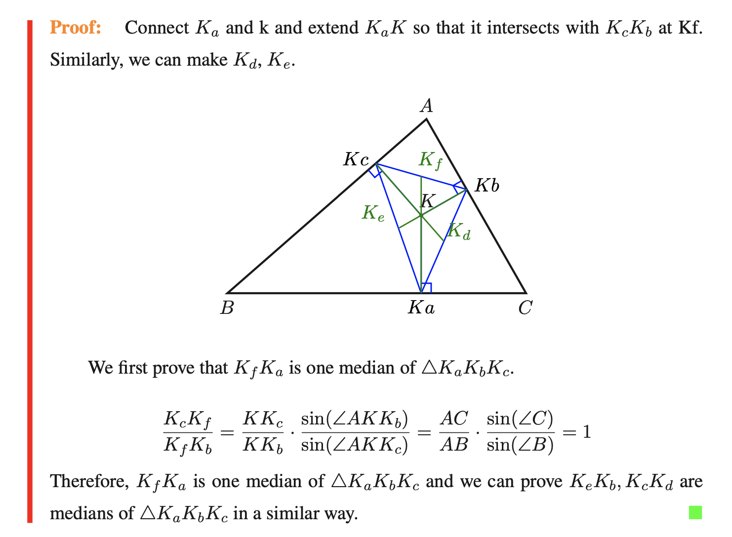
Notes:
Law of sines:sinA/a=sinB/b=sinC/c
It shall be sine(angle KKcKb), sine(angleKkbKc)

Slide 10
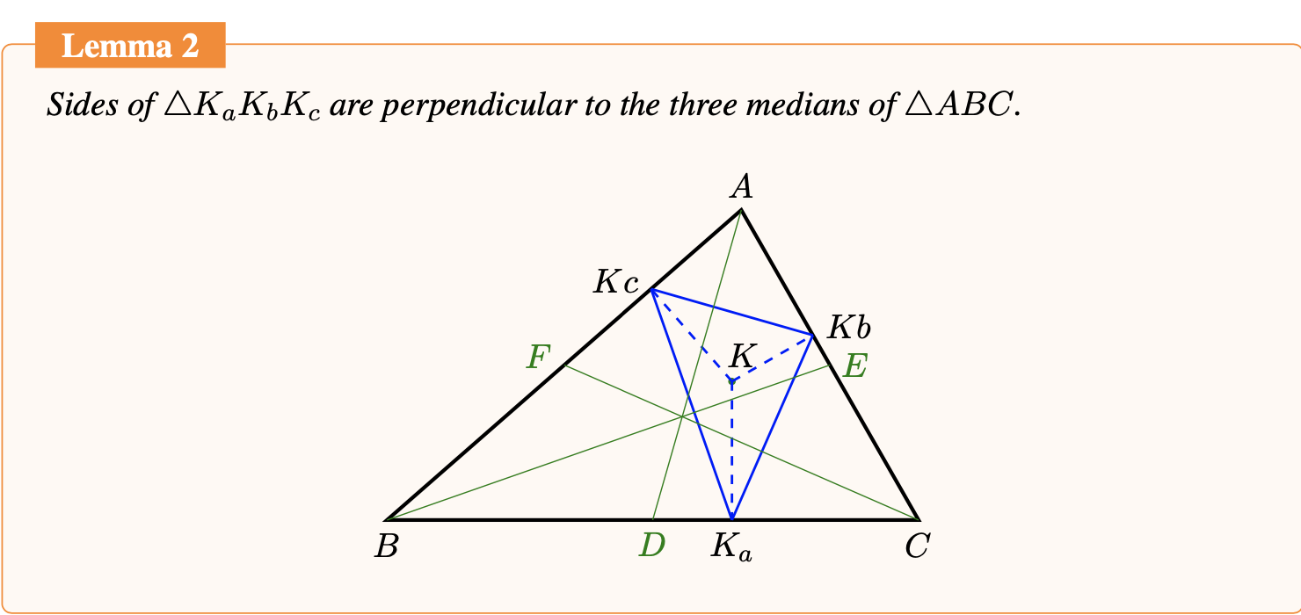

Slide 11
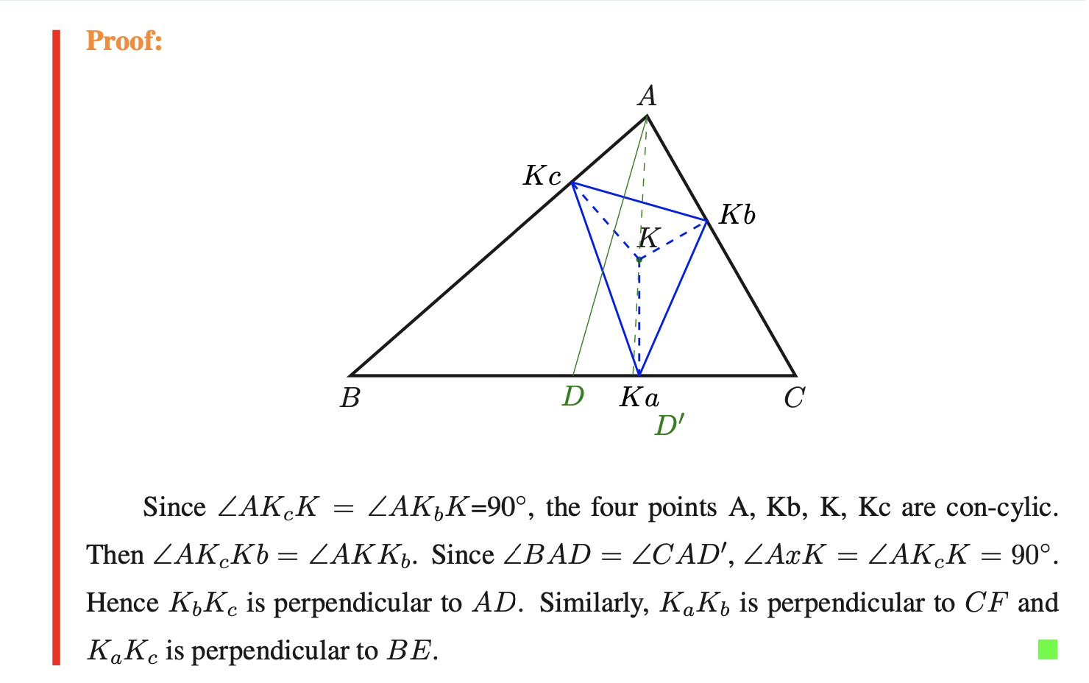
Notes:
It shall be angle x

Slide 12
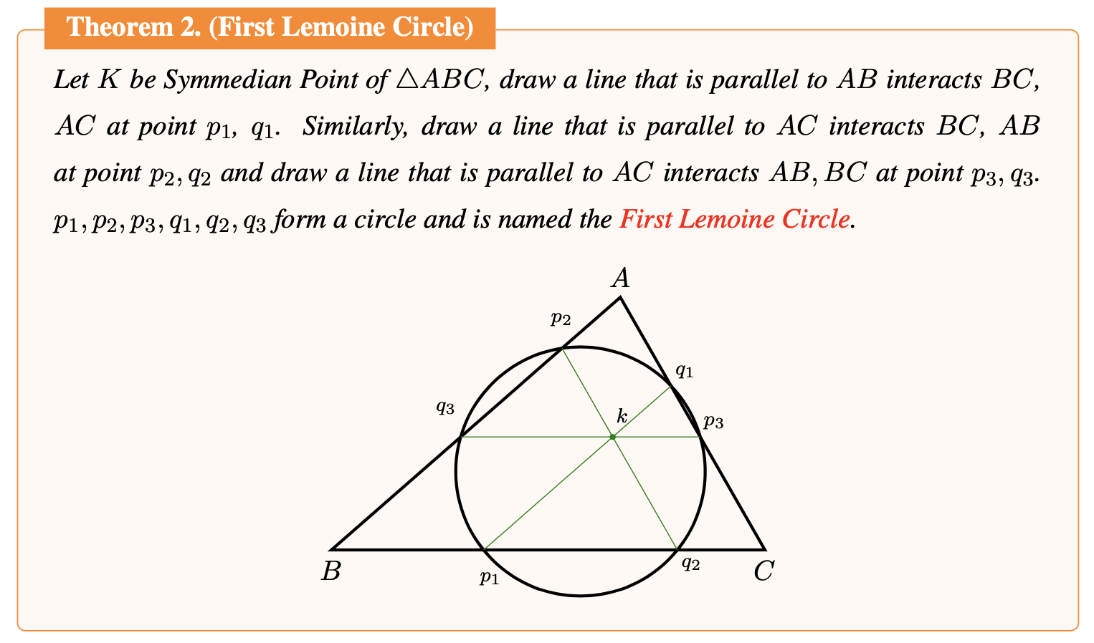
More Properties

Slide 13
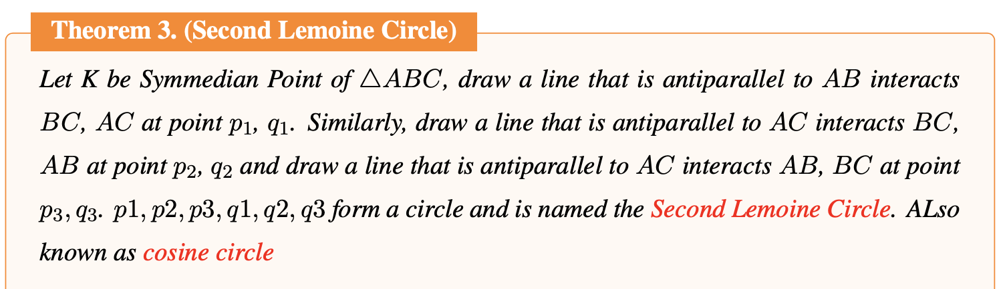
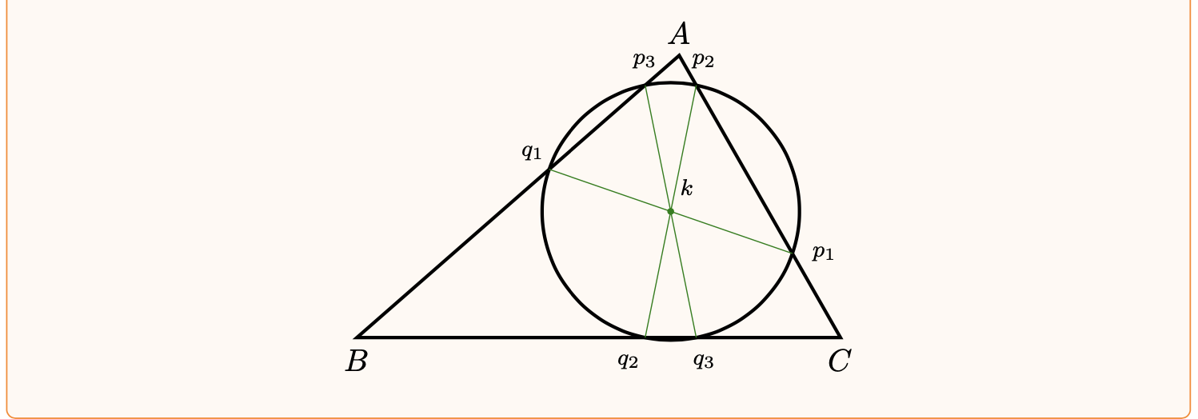
More Properties

Slide 14
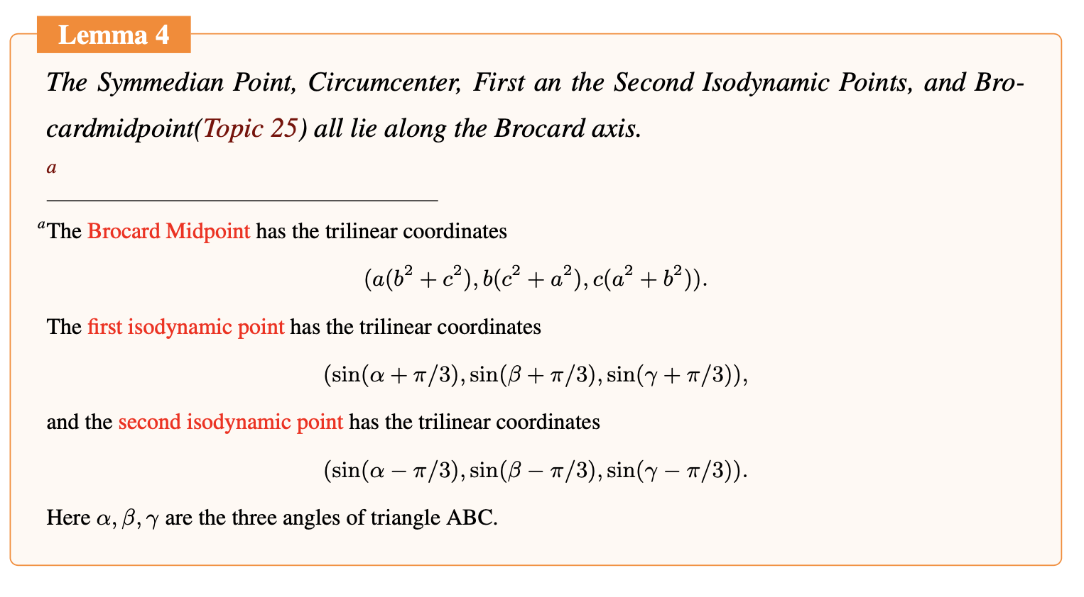
More Properties
Notes:
Linear algebra

Slide 15
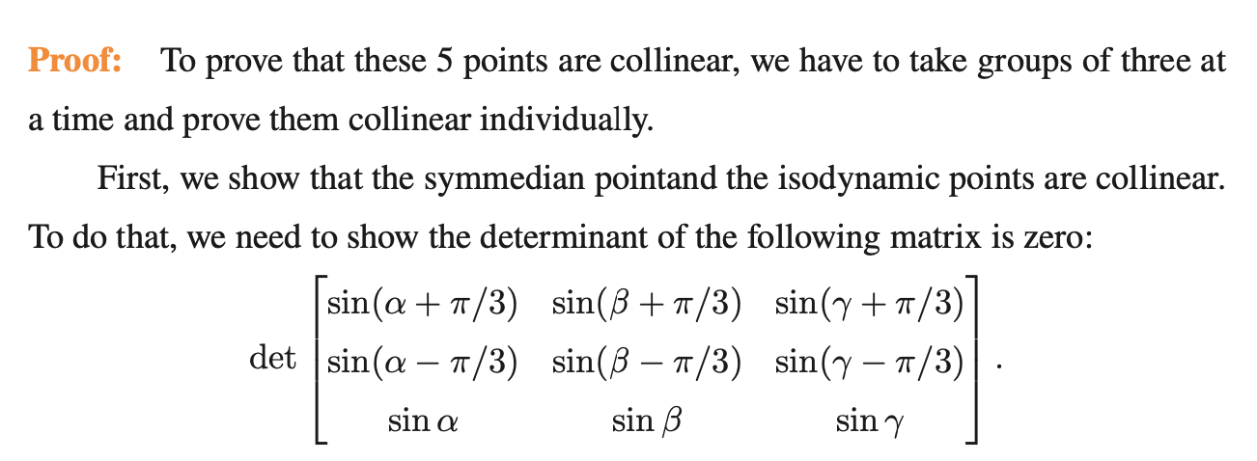
After several row operations, we can find that the determinant of this matrix is 0, which means that the symmedian point is collinear with the first and second isodynamic points

Slide 16
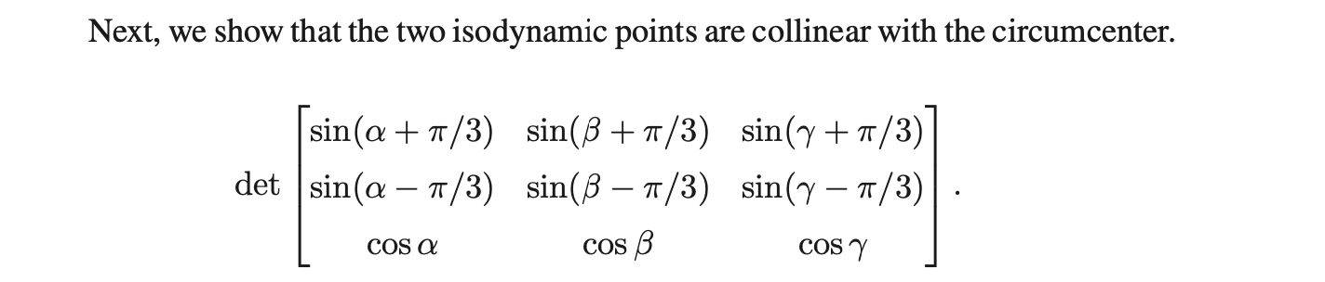
After several row operations, we can find that the determinant of this matrix is 0, the first and second isodynamic points are collinear with the circumcenter.
Since isodynamic points are also collinear with the symmedian point, as stated in the last slide, the four points: the first and second isodynamic points, symmedian point, and circumcenter are collinear.

Slide 17
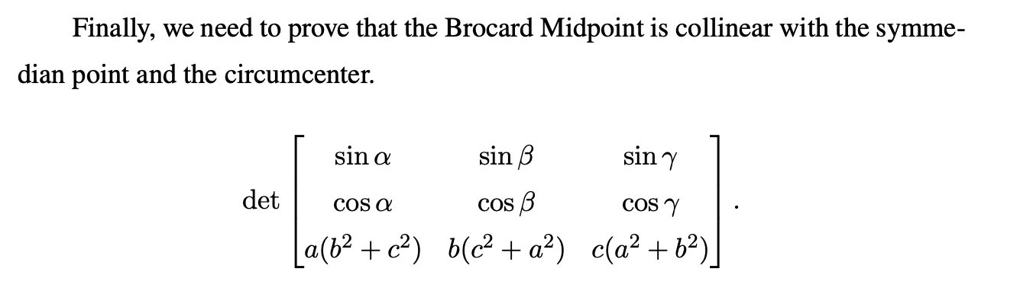
After several row operations, we can find that the determinant of this matrix is 0, the Brocard Midpoint is collinear with the symmedian point and the circumcenter.
And therefore the five points are collinear.

Slide 18
Thank you for listening!

